Slide 1
Hypothesis Testing
Chapter 10

Slide 2
Statistical Inference
When talking about inference, we have two main tools: confidence intervals and hypothesis testing. Chapter 9 covers confidence intervals and chapter 10 covers hypothesis testing.
In my mind, it makes more sense to start with hypothesis testing. That is by no means objectively true, but I think confidence intervals make more sense if we understand a little about hypothesis testing first.

Slide 3
Chapter 10
We begin chapter 10 by talking about some general ideas related to hypothesis testing. 10.2 and 10.3 lay out the steps of a hypothesis test as well as some general issues we need to be concerned with. Then we get into specific tests. 10.4 covers tests for a single mean while 10.5 covers tests for comparing two means.

Slide 4
10.1 – General Hypothesis Testing Concepts
We have already encountered several examples of (somewhat informal) hypothesis testing. Recall the examples in chapter 8 where we used probabilities from sampling distributions to test claims regarding population parameters. Those were essentially hypothesis tests.
While we will formalize hypothesis testing a little bit more than what we saw there, the underlying idea is exactly the same.

Slide 5
10.1 – General Hypothesis Testing Concepts
When we say hypothesis in statistics, we are talking about an assertion or conjecture concerning one or more populations. In particular, our assertions or conjectures relate to the parameters of the population(s).
These hypotheses must have a yes or no answer – they must be either objectively true or false. Recall for one example we did that the conjecture was that the mean of a distribution was 500. Either this is true or false, there can be no grey area regarding this hypothesis.
  Just because the assertion/conjecture must be objectively true or false, we may not always be able to know, even with good data, whether it is true or false. We will talk about some issues related to this idea in 10.2.

Slide 6
10.1 – General Hypothesis Testing Concepts
In hypothesis testing, we always have two competing (contradictory) hypotheses – the null hypothesis and the alternative hypothesis.
Usually, the alternative hypothesis represents the question to be answered or the theory to be tested. The null hypothesis nullifies or opposes the alternative hypothesis – it is the logical complement to the alternative hypothesis.

Slide 7
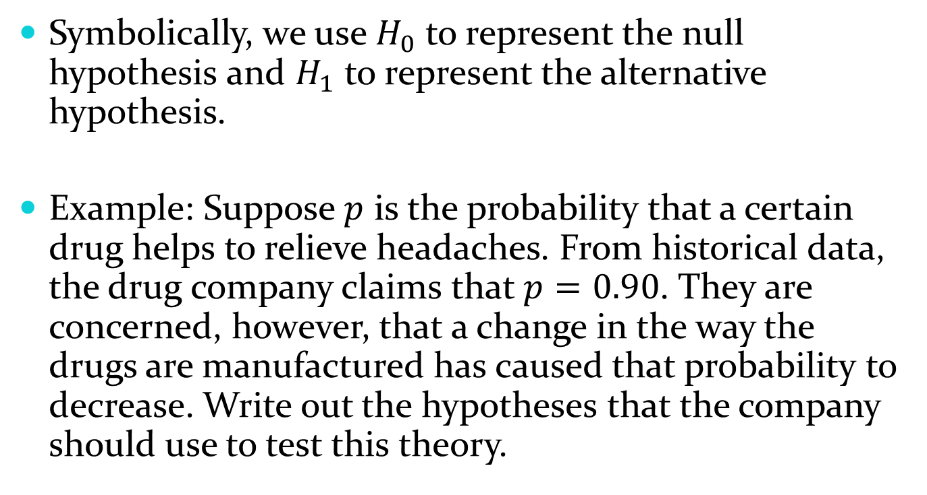
10.1 – General Hypothesis Testing Concepts
Symbolically, we use $H_{0}$ to represent the null hypothesis and $H_{1}$ to represent the alternative hypothesis.
Example: Suppose $p$ is the probability that a certain drug helps to relieve headaches. From historical data, the drug company claims that $p=0.90$. They are concerned, however, that a change in the way the drugs are manufactured has caused that probability to decrease. Write out the hypotheses that the company should use to test this theory.

Slide 8
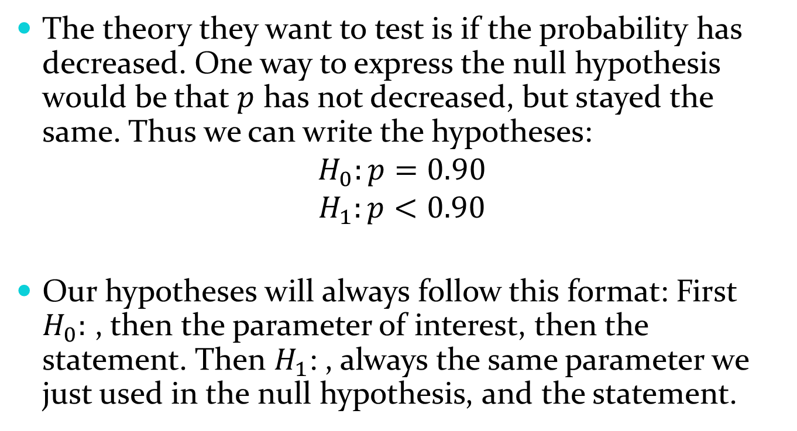
10.1 – General Hypothesis Testing Concepts
The theory they want to test is if the probability has decreased. One way to express the null hypothesis would be that $p$ has not decreased, but stayed the same. Thus we can write the hypotheses:
$$H_{0}:p=0.90$$
$$H_{1}:p<0.90$$
Our hypotheses will always follow this format: First $H_{0}:$ , then the parameter of interest, then the statement. Then $H_{1}$: , always the same parameter we just used in the null hypothesis, and the statement.

Slide 9
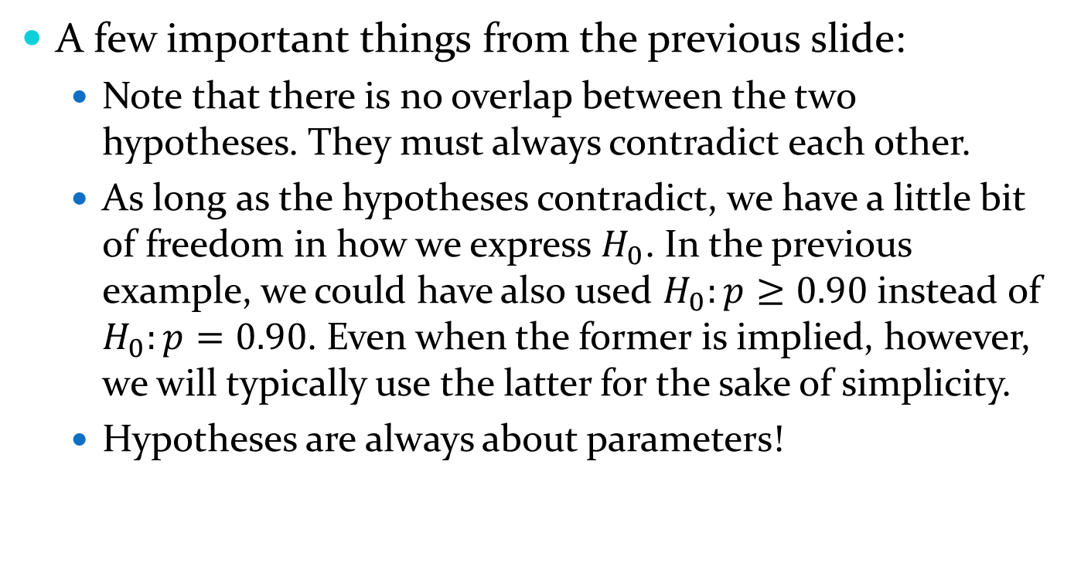
10.1 – General Hypothesis Testing Concepts
A few important things from the previous slide:
  Note that there is no overlap between the two hypotheses. They must always contradict each other.
  As long as the hypotheses contradict, we have a little bit of freedom in how we express $H_{0}$. In the previous example, we could have also used $H_{0}:p≥0.90$ instead of $H_{0}:p=0.90$. Even when the former is implied, however, we will typically use the latter for the sake of simplicity.
  Hypotheses are always about parameters!

Slide 10
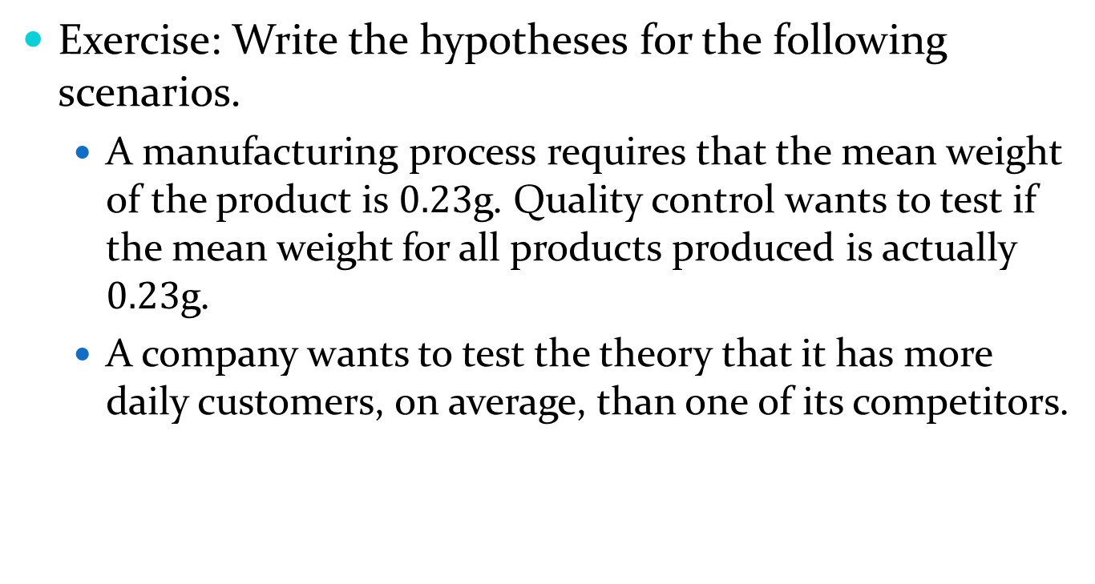
10.1 – General Hypothesis Testing Concepts
Exercise: Write the hypotheses for the following scenarios.
  A manufacturing process requires that the mean weight of the product is $0.23$g. Quality control wants to test if the mean weight for all products produced is actually $0.23$g.
  A company wants to test the theory that it has more daily customers, on average, than one of its competitors.

Slide 11
10.1 – General Hypothesis Testing Concepts
We will spend a good portion of this chapter on how to make decisions regarding hypotheses. For now, we just need some general ideas.
The way we decide which hypothesis our data support is all based on probability. The probability we use is the probability of observing a statistic at least as extreme as our actual statistic, if the null hypothesis were actually true. (this is the definition of a p-value)

Slide 12
10.1 – General Hypothesis Testing Concepts
That is, we assume the null hypothesis is true. Then we use the sampling (null) distribution of our statistic to see how likely our statistic is to occur under that assumption. If that probability is small, then we have evidence that the null hypothesis is not likely to be true. This is a lot like a proof by contradiction in math (for those that have seen that before) – we assume the opposite of what we want to show, then show that that assumption is not reasonable.

Slide 13
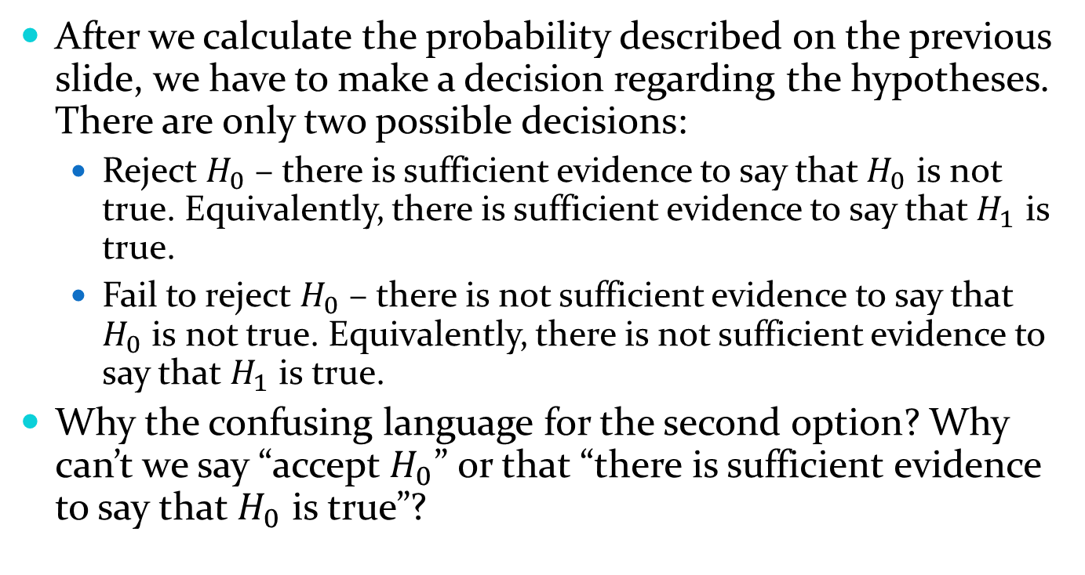
10.1 – General Hypothesis Testing Concepts
After we calculate the probability described on the previous slide, we have to make a decision regarding the hypotheses. There are only two possible decisions:
  Reject $H_{0}$ – there is sufficient evidence to say that $H_{0}$ is not true. Equivalently, there is sufficient evidence to say that $H_{1}$ is true.
  Fail to reject $H_{0}$ – there is not sufficient evidence to say that $H_{0}$ is not true. Equivalently, there is not sufficient evidence to say that $H_{1}$ is true.
Why the confusing language for the second option? Why can’t we say “accept $H_{0}$” or that “there is sufficient evidence to say that $H_{0}$ is true”?

Slide 14
10.1 – General Hypothesis Testing Concepts
One example that we will come back to in 10.2 is that of a jury trial. We’ve all heard the phrase “innocent until proven guilty.” A jury trial is really just a hypothesis test. What are the null and alternative hypotheses that are used?

Slide 15
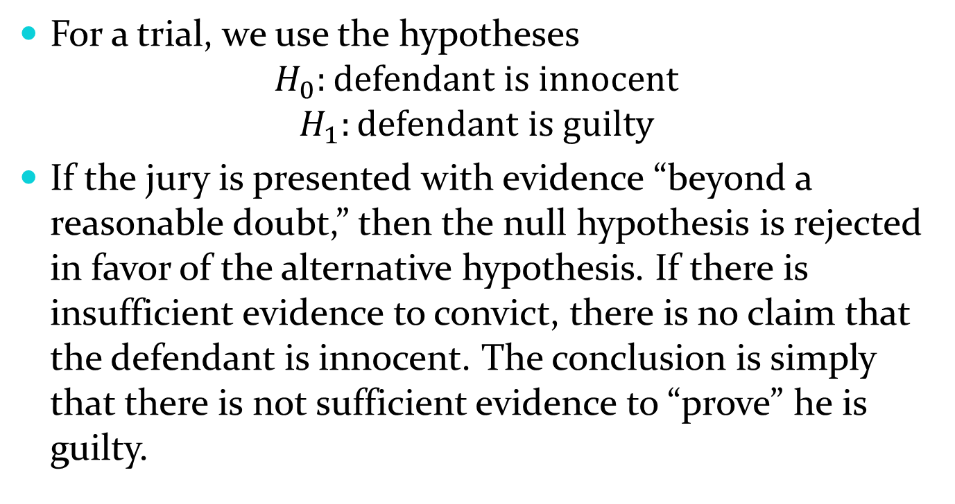
10.1 – General Hypothesis Testing Concepts
For a trial, we use the hypotheses
$$H_{0}:defendant is innocent$$
$$H_{1}:defendant is guilty$$
If the jury is presented with evidence “beyond a reasonable doubt,” then the null hypothesis is rejected in favor of the alternative hypothesis. If there is insufficient evidence to convict, there is no claim that the defendant is innocent. The conclusion is simply that there is not sufficient evidence to “prove” he is guilty.

Slide 16
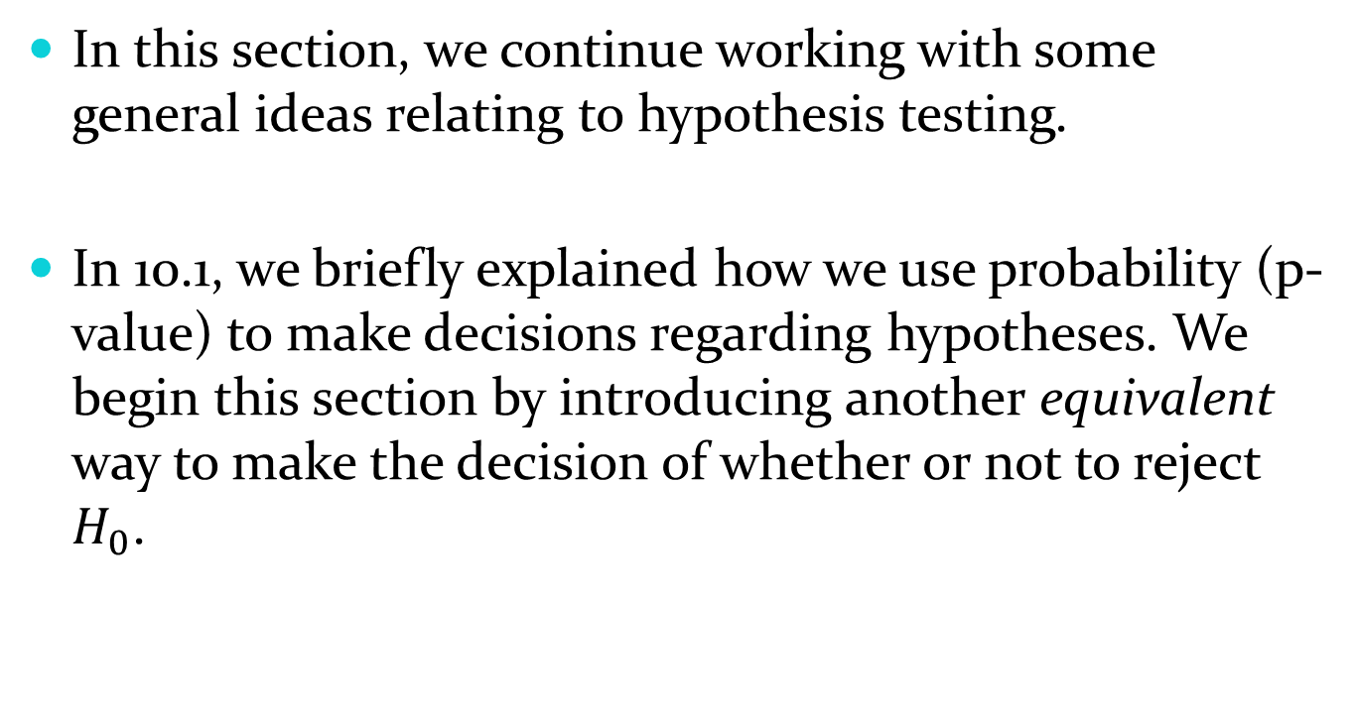
10.2 – Testing a Hypothesis
In this section, we continue working with some general ideas relating to hypothesis testing.
In 10.1, we briefly explained how we use probability (p-value) to make decisions regarding hypotheses. We begin this section by introducing another equivalent way to make the decision of whether or not to reject $H_{0}$.

Slide 17
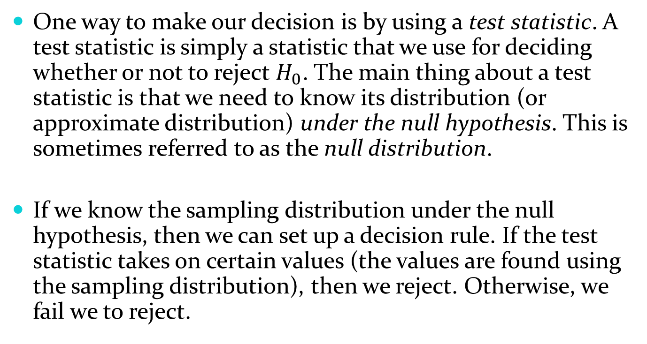
10.2 – Testing a Hypothesis
One way to make our decision is by using a test statistic. A test statistic is simply a statistic that we use for deciding whether or not to reject $H_{0}$. The main thing about a test statistic is that we need to know its distribution (or approximate distribution) under the null hypothesis. This is sometimes referred to as the null distribution.
If we know the sampling distribution under the null hypothesis, then we can set up a decision rule. If the test statistic takes on certain values (the values are found using the sampling distribution), then we reject. Otherwise, we fail we to reject.

Slide 18
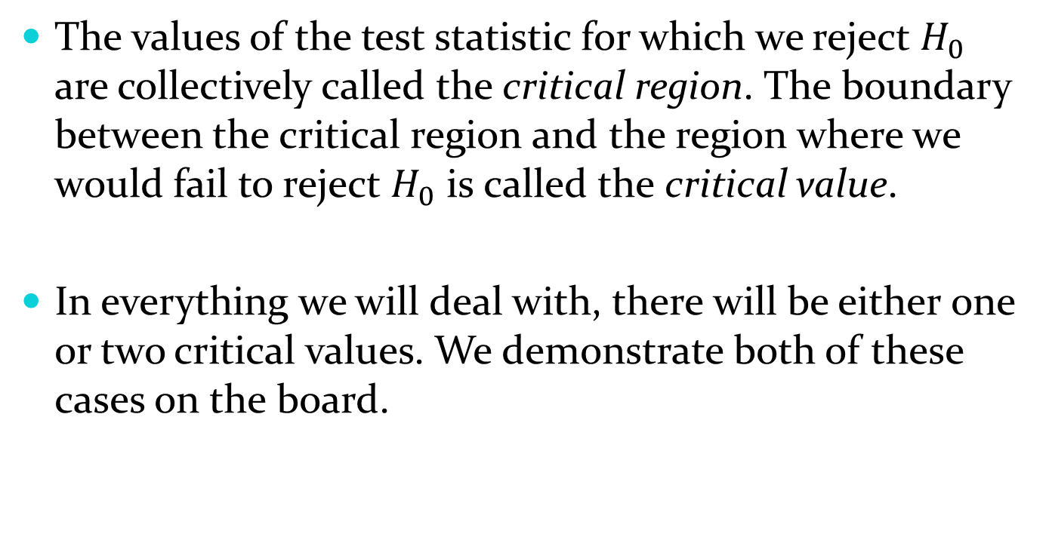
10.2 – Testing a Hypothesis
The values of the test statistic for which we reject $H_{0}$ are collectively called the critical region. The boundary between the critical region and the region where we would fail to reject $H_{0}$ is called the critical value.
In everything we will deal with, there will be either one or two critical values. We demonstrate both of these cases on the board.

Slide 19
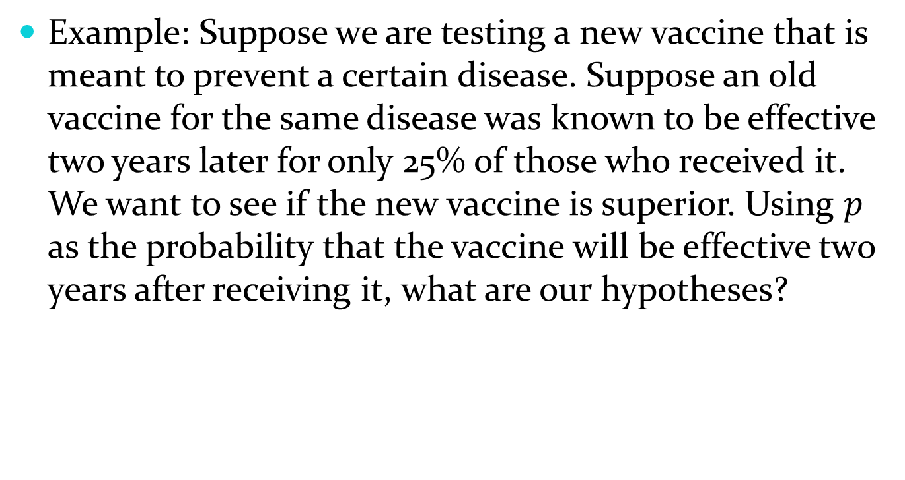
10.2 – Testing a Hypothesis
Example: Suppose we are testing a new vaccine that is meant to prevent a certain disease. Suppose an old vaccine for the same disease was known to be effective two years later for only 25% of those who received it. We want to see if the new vaccine is superior. Using $p$ as the probability that the vaccine will be effective two years after receiving it, what are our hypotheses?

Slide 20
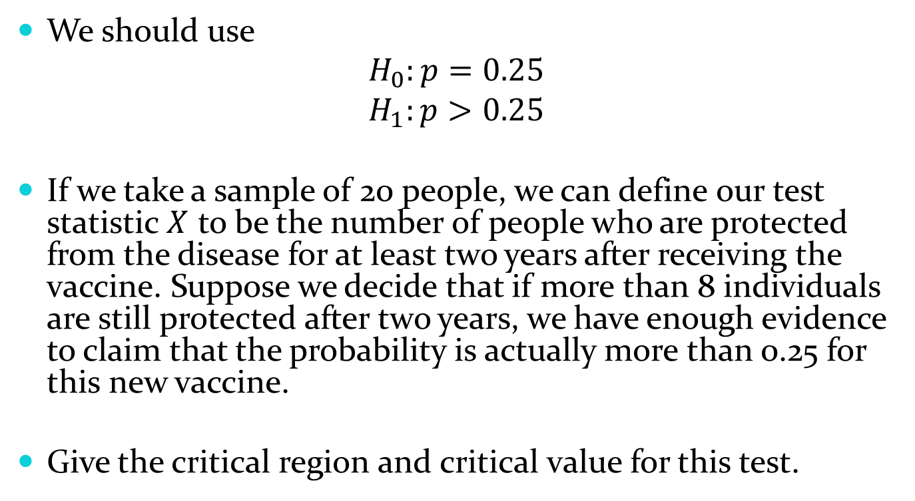
10.2 – Testing a Hypothesis
We should use
$$H_{0}:p=0.25$$
$$H_{1}:p>0.25$$
If we take a sample of 20 people, we can define our test statistic $X$ to be the number of people who are protected from the disease for at least two years after receiving the vaccine. Suppose we decide that if more than 8 individuals are still protected after two years, we have enough evidence to claim that the probability is actually more than 0.25 for this new vaccine.
Give the critical region and critical value for this test.

Slide 21
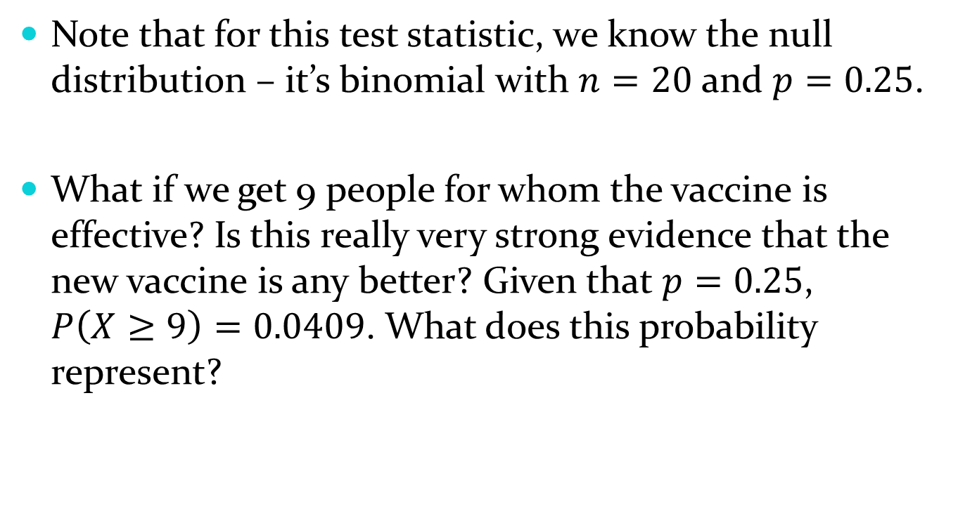
10.2 – Testing a Hypothesis
Note that for this test statistic, we know the null distribution – it’s binomial with $n=20$ and $p=0.25$.
What if we get 9 people for whom the vaccine is effective? Is this really very strong evidence that the new vaccine is any better? Given that $p=0.25$, $P\left(X≥9\right)=0.0409$. What does this probability represent?

Slide 22
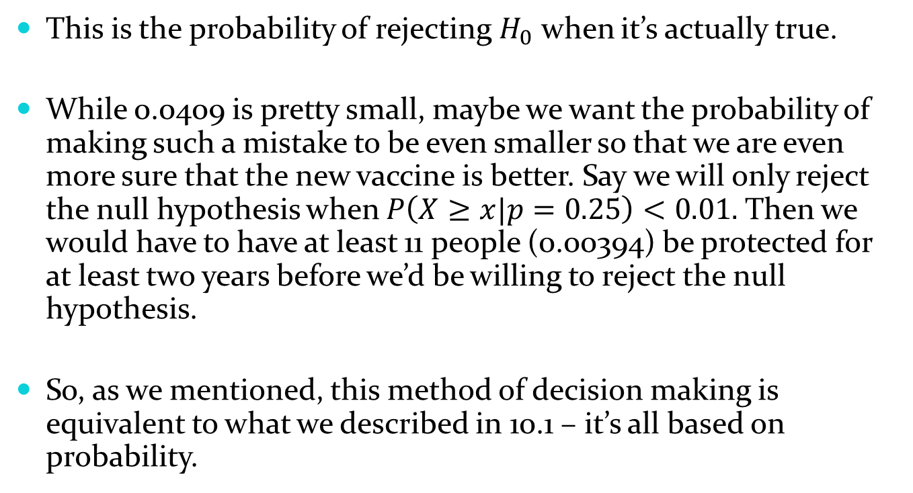
10.2 – Testing a Hypothesis
This is the probability of rejecting $H_{0}$ when it’s actually true.
While 0.0409 is pretty small, maybe we want the probability of making such a mistake to be even smaller so that we are even more sure that the new vaccine is better. Say we will only reject the null hypothesis when $P\left(X≥x|p=0.25\right)<0.01.$Then we would have to have at least 11 people (0.00394) be protected for at least two years before we’d be willing to reject the null hypothesis.
So, as we mentioned, this method of decision making is equivalent to what we described in 10.1 – it’s all based on probability.

Slide 23
10.2 – Testing a Hypothesis
This idea leads us into the next topic: types of errors. The reason we made the acceptable probability smaller in the previous example was because we didn’t want to conclude that the new vaccine was better when it actually wasn’t.
We were trying to protect against making what is called a type I error, or false positive.

Slide 24
10.2 – Testing a Hypothesis
A type I error occurs when we reject a true null hypothesis. This is called a false positive or you can think of it as a “false alarm.”
A type II error occurs when we fail to reject a false null hypothesis. This is called a false negative, or you can think of it as a “missed opportunity.”
These are summarized well with a table.

Slide 25
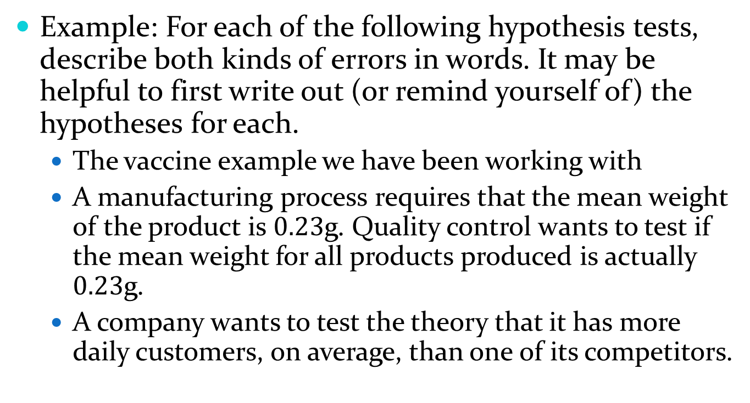
10.2 – Testing a Hypothesis
Example: For each of the following hypothesis tests, describe both kinds of errors in words. It may be helpful to first write out (or remind yourself of) the hypotheses for each.
  The vaccine example we have been working with
  A manufacturing process requires that the mean weight of the product is $0.23$g. Quality control wants to test if the mean weight for all products produced is actually $0.23$g.
  A company wants to test the theory that it has more daily customers, on average, than one of its competitors.

Slide 26
10.2 – Testing a Hypothesis
Vaccine example:
  A type I error would be claiming the new vaccine is superior when in fact it is not.
  A type II error would be failing to find that the new vaccine is superior when it actually is.
Manufacturing:
  Type I: Claiming that the mean weight is not 0.23 when it really is.
  Type II: Failing to claim that the mean is not 0.23 when it is not actually 0.23.
Daily customers:
  Type I: Claiming that the company has more daily customers, on average, when, in reality, the competitor has more.
  Type II: Failing to find that the company has more daily customers, on average, when they really do.

Slide 27
10.2 – Testing a Hypothesis
Which type of error is worse depends largely on the context. Think about the examples we just looked at. Which error is worse in each example? It may be hard to tell.
Typically in statistics, we are more concerned with making type I than type II errors. For this reason, critical regions for hypothesis tests are based on the probability of a type I error. That is, we set the probability of making a type I error to some acceptable level (like we did in the vaccine example using 0.01) and use that to define the critical region.

Slide 28
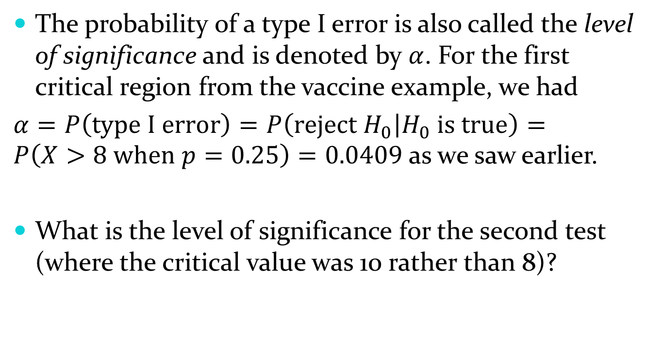
10.2 – Testing a Hypothesis
The probability of a type I error is also called the level of significance and is denoted by $α$. For the first critical region from the vaccine example, we had
$α=P\left(type I error\right)=P\left(reject H_{0} | H_{0} is true\right)=P\left(X>8 when p=0.25\right)=0.0409$ as we saw earlier.
What is the level of significance for the second test (where the critical value was 10 rather than 8)?

Slide 29
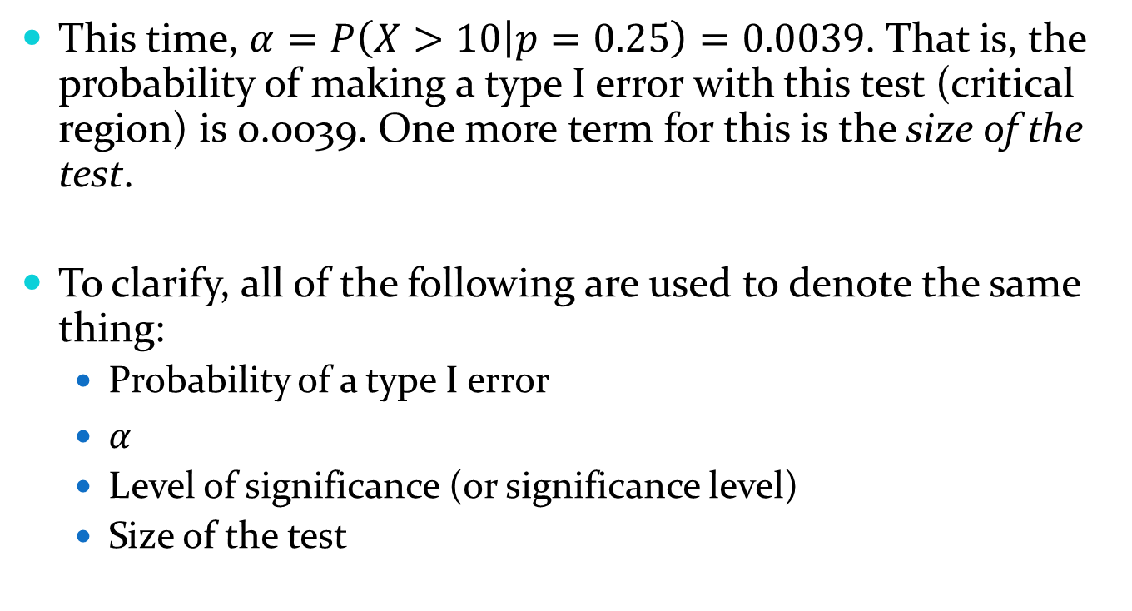
10.2 – Testing a Hypothesis
This time, $α=P\left(X>10 | p=0.25\right)=0.0039$. That is, the probability of making a type I error with this test (critical region) is 0.0039. One more term for this is the size of the test.
To clarify, all of the following are used to denote the same thing:
  Probability of a type I error
  $α$
  Level of significance (or significance level)
  Size of the test

Slide 30
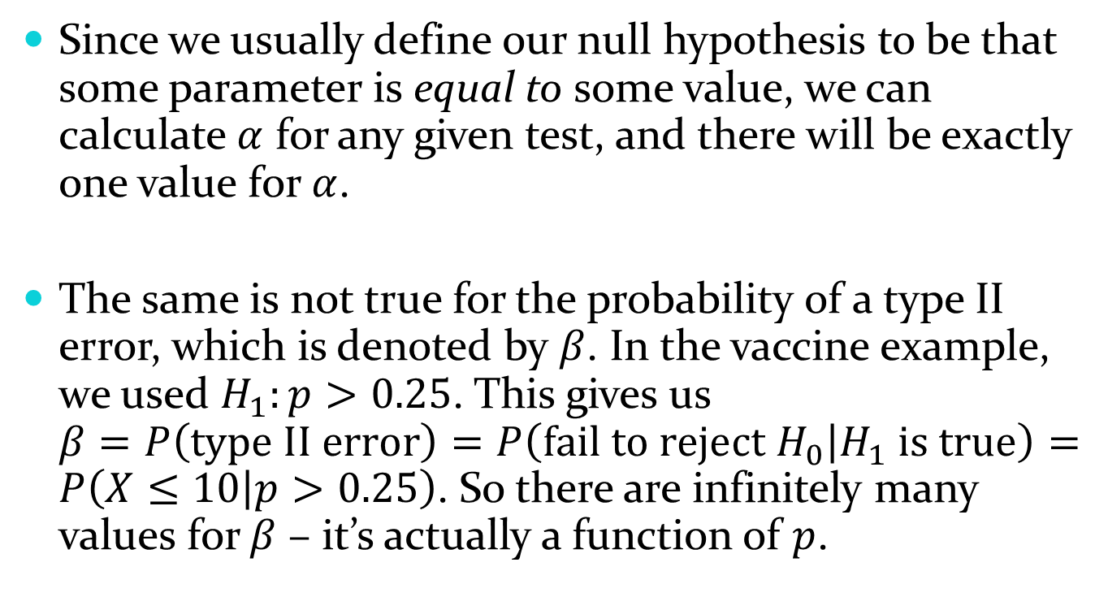
10.2 – Testing a Hypothesis
Since we usually define our null hypothesis to be that some parameter is equal to some value, we can calculate $α$ for any given test, and there will be exactly one value for $α$.
The same is not true for the probability of a type II error, which is denoted by $β$. In the vaccine example, we used $H_{1}:p>0.25$. This gives us $β=P\left(type II error\right)=P\left(fail to reject H_{0} | H_{1} is true\right)=P\left(X≤10 | p>0.25\right)$. So there are infinitely many values for $β$ – it’s actually a function of $p$.

Slide 31
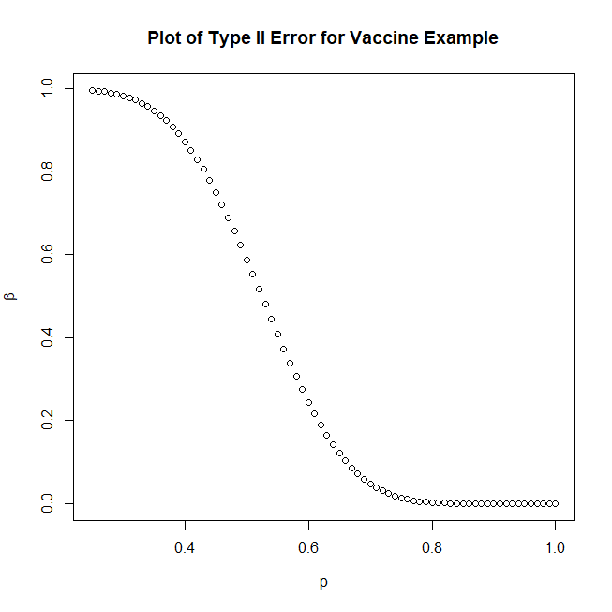
10.2 – Testing a Hypothesis

Slide 32
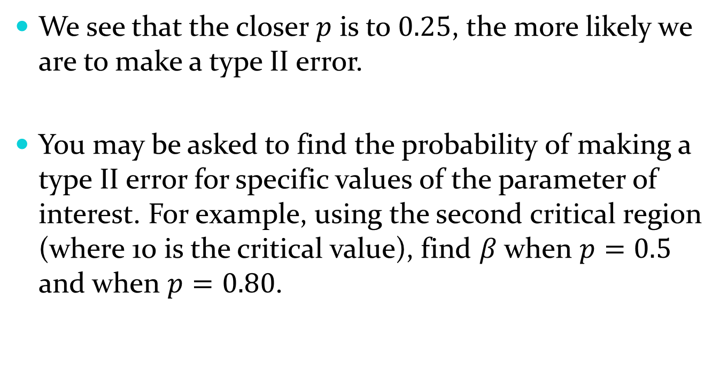
10.2 – Testing a Hypothesis
We see that the closer $p$ is to $0.25$, the more likely we are to make a type II error.
You may be asked to find the probability of making a type II error for specific values of the parameter of interest. For example, using the second critical region (where 10 is the critical value), find $β$ when $p=0.5$ and when $p=0.80$.

Slide 33

10.2 – Testing a Hypothesis
We have $P\left(X≤10\right|p=0.5)=0.5881$ and $P\left(X≤10 | p=0.80\right)=0.0026$. These can be found on table A.1 or the app.

Slide 34

10.2 – Testing a Hypothesis
Let’s look back at an illustration of the critical region. Without calculating anything (or with calculations if you really want), what happens to $α$ and $β$ if I change the size of the critical region?

Slide 35
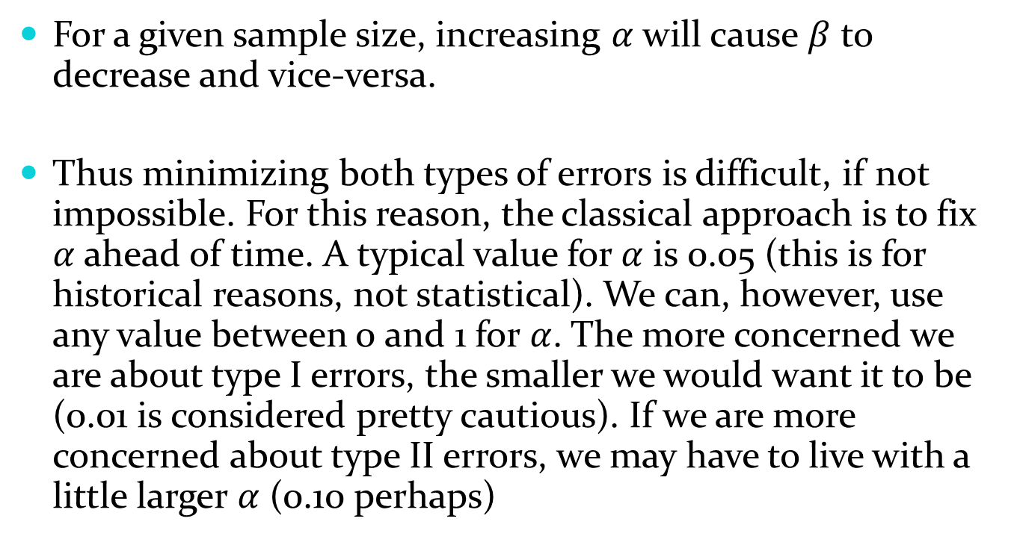
10.2 – Testing a Hypothesis
For a given sample size, increasing $α$ will cause $β$ to decrease and vice-versa.
Thus minimizing both types of errors is difficult, if not impossible. For this reason, the classical approach is to fix $α$ ahead of time. A typical value for $α$ is 0.05 (this is for historical reasons, not statistical). We can, however, use any value between 0 and 1 for $α$. The more concerned we are about type I errors, the smaller we would want it to be (0.01 is considered pretty cautious). If we are more concerned about type II errors, we may have to live with a little larger $α$ (0.10 perhaps)

Slide 36

10.2 – Testing a Hypothesis
Let’s look at an example involving a continuous random variable. Suppose we want to test the theory that the average GPA at UNL is 3.0. Let’s assume that $σ/\sqrt{n}=0.27$. First, what should we use as the null and alternative hypotheses?

Slide 37
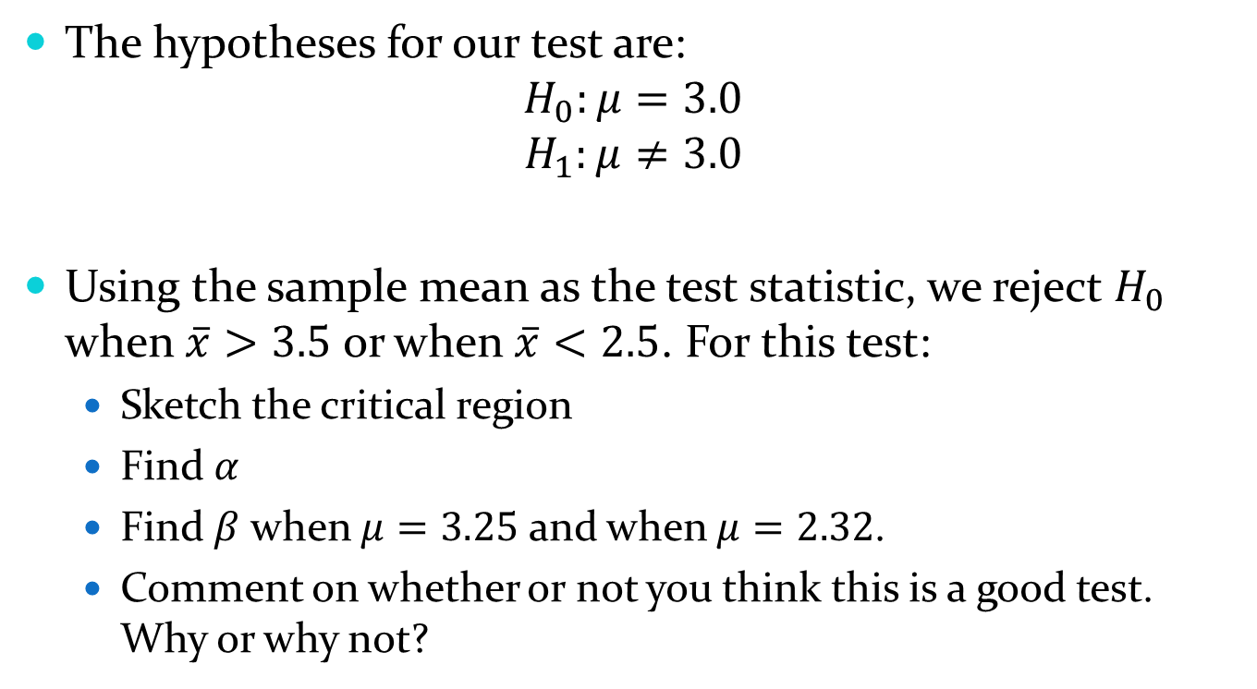
10.2 – Testing a Hypothesis
The hypotheses for our test are:
$$H_{0}:μ=3.0$$
$$H_{1}:μ≠3.0$$
Using the sample mean as the test statistic, we reject $H_{0}$ when $\overline{x}>3.5$ or when $\overline{x}<2.5$. For this test:
  Sketch the critical region
  Find $α$
  Find $β$ when $μ=3.25$ and when $μ=2.32$.
  Comment on whether or not you think this is a good test. Why or why not?

Slide 38
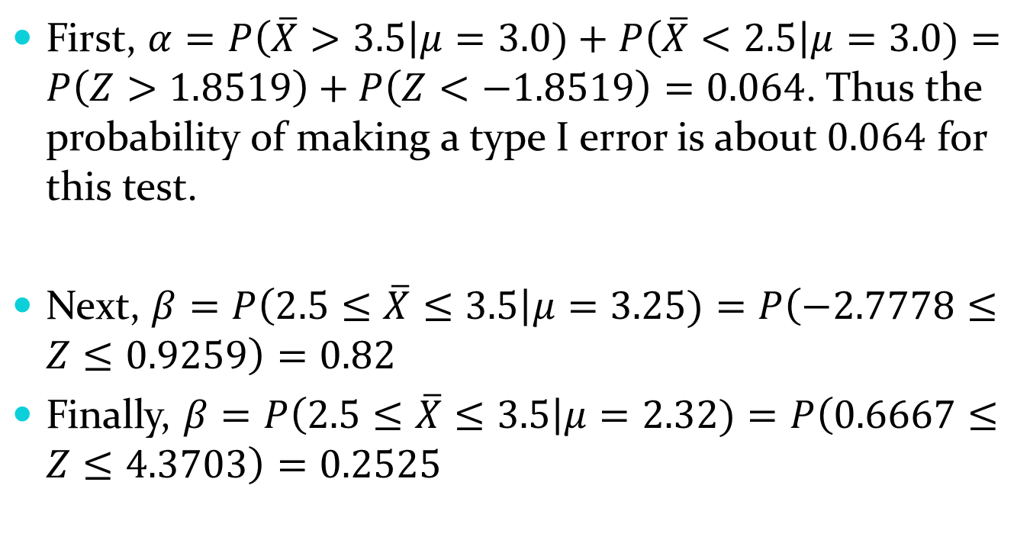
10.2 – Testing a Hypothesis
First, $α=P\left(\overline{X}>3.5\right|μ=3.0)+P\left(\overline{X}<2.5\right|μ=3.0)=P\left(Z>1.8519\right)+P\left(Z<−1.8519\right)=0.064$. Thus the probability of making a type I error is about $0.064$ for this test.
Next, $β=P\left(2.5≤\overline{X}≤3.5\right|μ=3.25)=P\left(−2.7778≤Z≤0.9259\right)=0.82$
Finally, $β=P\left(2.5≤\overline{X}≤3.5\right|μ=2.32)=P\left(0.6667≤Z≤4.3703\right)=0.2525$

Slide 39
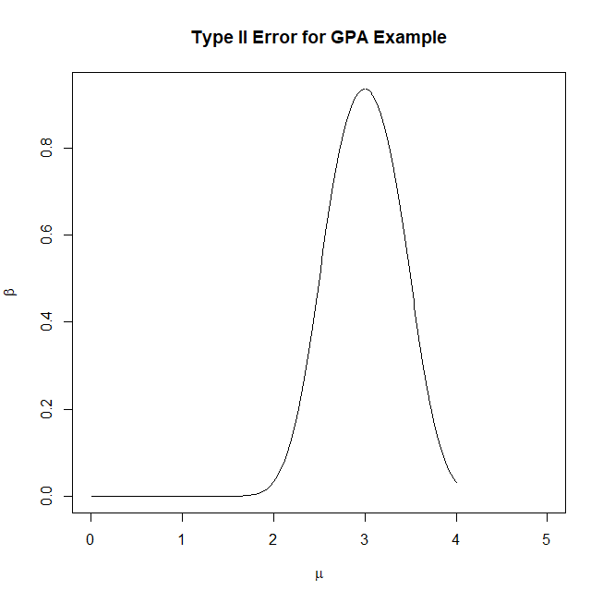
10.2 – Testing a Hypothesis

Slide 40

10.2 – Testing a Hypothesis
Before answering whether or not you think this is a good test, think about this: If we didn’t know $σ$ but instead had estimated it from our sample, what would we do differently in that problem? Hint: Think back to 8.6.

Slide 41
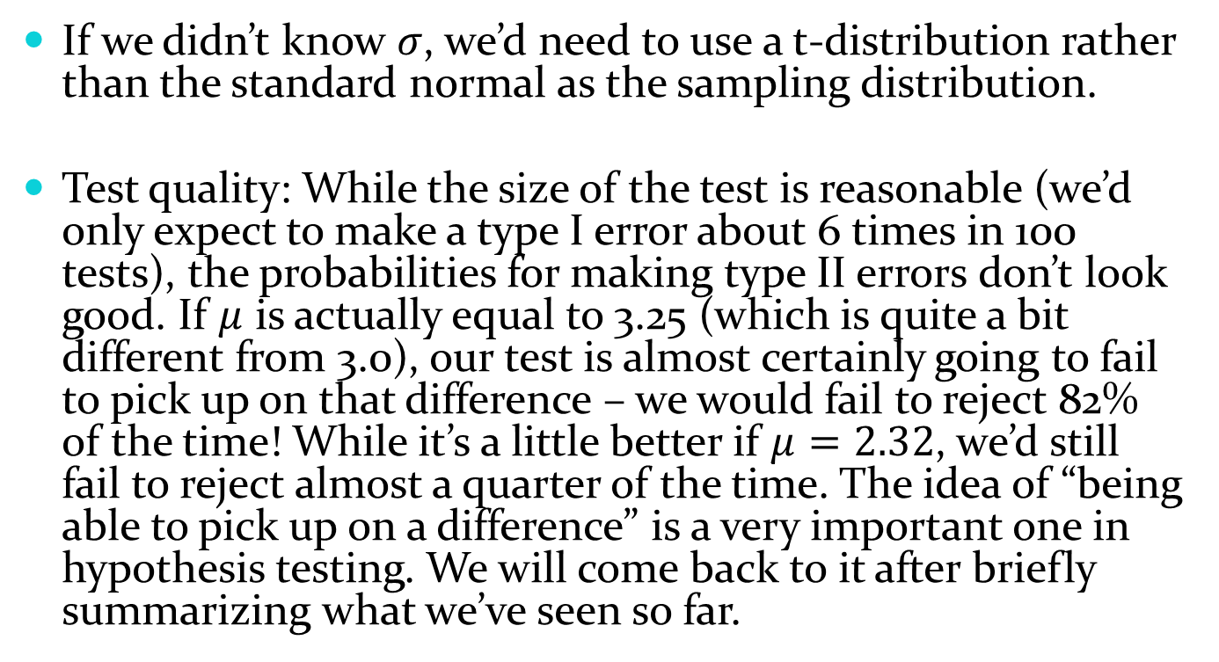
10.2 – Testing a Hypothesis
If we didn’t know $σ$, we’d need to use a t-distribution rather than the standard normal as the sampling distribution.
Test quality: While the size of the test is reasonable (we’d only expect to make a type I error about 6 times in 100 tests), the probabilities for making type II errors don’t look good. If $μ$ is actually equal to 3.25 (which is quite a bit different from 3.0), our test is almost certainly going to fail to pick up on that difference – we would fail to reject 82% of the time! While it’s a little better if $μ=2.32$, we’d still fail to reject almost a quarter of the time. The idea of “being able to pick up on a difference” is a very important one in hypothesis testing. We will come back to it after briefly summarizing what we’ve seen so far.

Slide 42
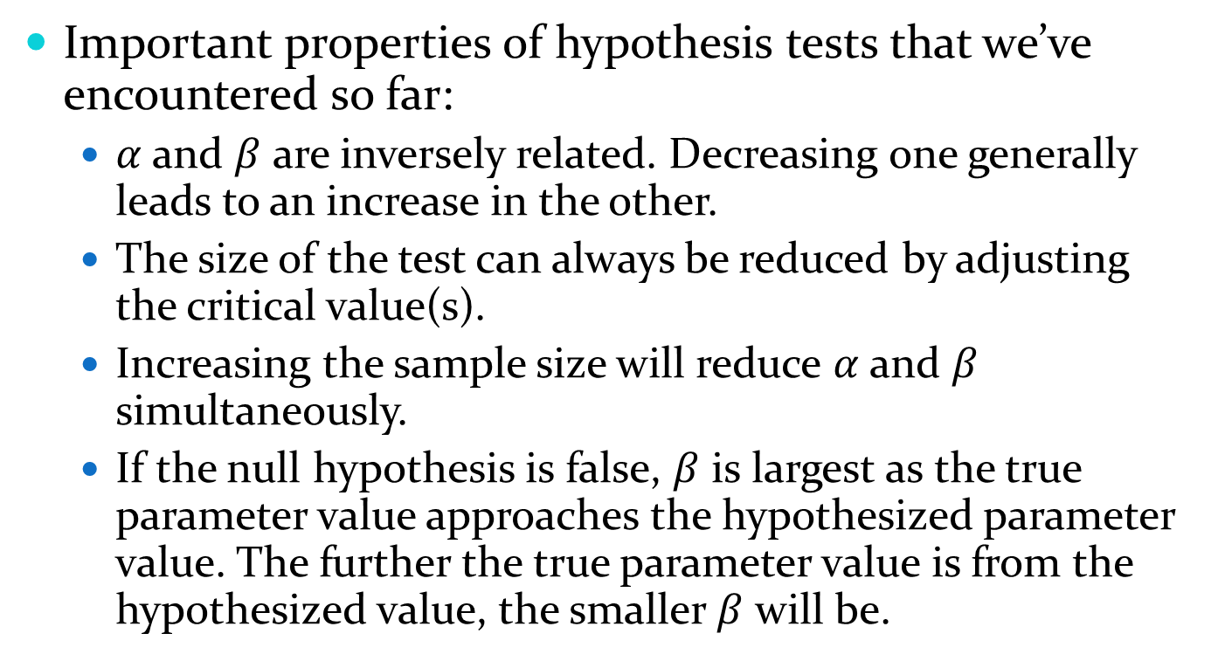
10.2 – Testing a Hypothesis
Important properties of hypothesis tests that we’ve encountered so far:
  $α$ and $β$ are inversely related. Decreasing one generally leads to an increase in the other.
  The size of the test can always be reduced by adjusting the critical value(s).
  Increasing the sample size will reduce $α$ and $β$ simultaneously.
  If the null hypothesis is false, $β$ is largest as the true parameter value approaches the hypothesized parameter value. The further the true parameter value is from the hypothesized value, the smaller $β$ will be.

Slide 43
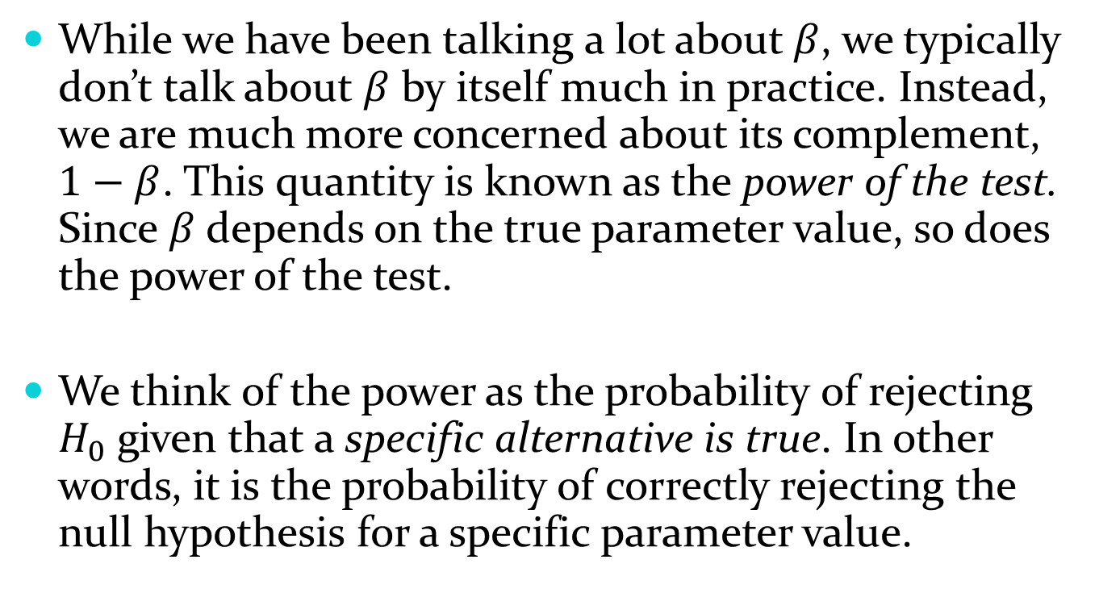
10.2 – Testing a Hypothesis
While we have been talking a lot about $β$, we typically don’t talk about $β$ by itself much in practice. Instead, we are much more concerned about its complement, $1−β$. This quantity is known as the power of the test. Since $β$ depends on the true parameter value, so does the power of the test.
We think of the power as the probability of rejecting $H_{0}$ given that a specific alternative is true. In other words, it is the probability of correctly rejecting the null hypothesis for a specific parameter value.

Slide 44
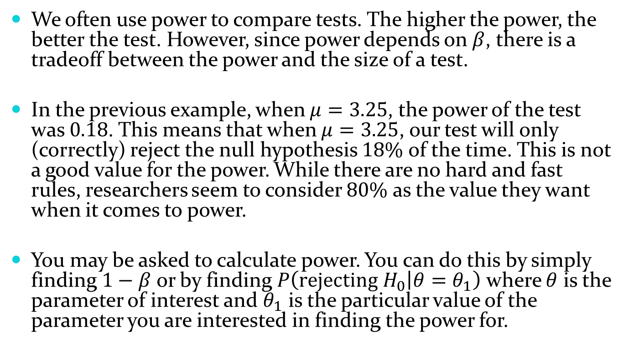
10.2 – Testing a Hypothesis
We often use power to compare tests. The higher the power, the better the test. However, since power depends on $β$, there is a tradeoff between the power and the size of a test.
In the previous example, when $μ=3.25$, the power of the test was $0.18$. This means that when $μ=3.25$, our test will only (correctly) reject the null hypothesis $18\%$ of the time. This is not a good value for the power. While there are no hard and fast rules, researchers seem to consider $80\%$ as the value they want when it comes to power.
You may be asked to calculate power. You can do this by simply finding $1−β$ or by finding $P\left(rejecting H_{0} | θ=θ_{1}\right)$ where $θ$ is the parameter of interest and $θ_{1}$ is the particular value of the parameter you are interested in finding the power for.

Slide 45
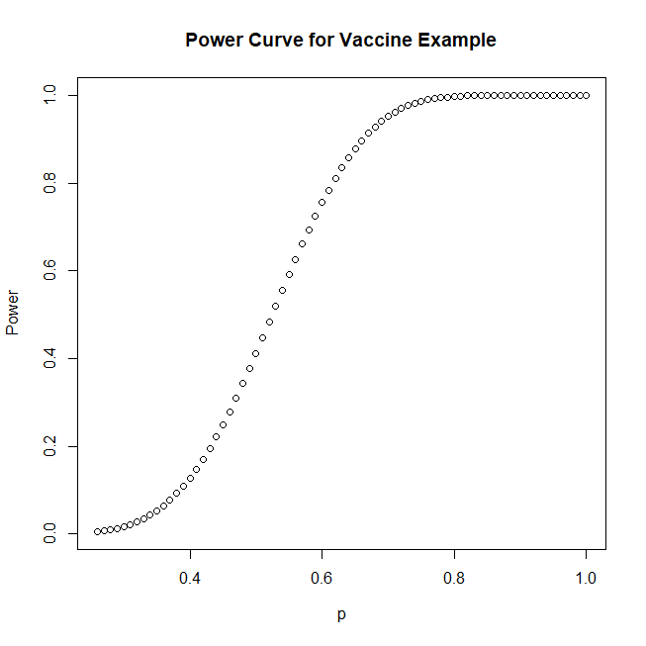
10.2 – Testing a Hypothesis

Slide 46
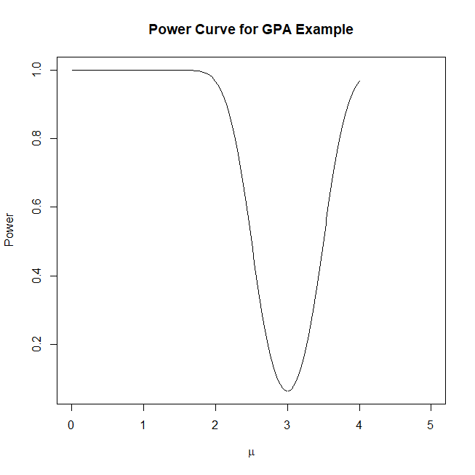
10.2 – Testing a Hypothesis

Slide 47
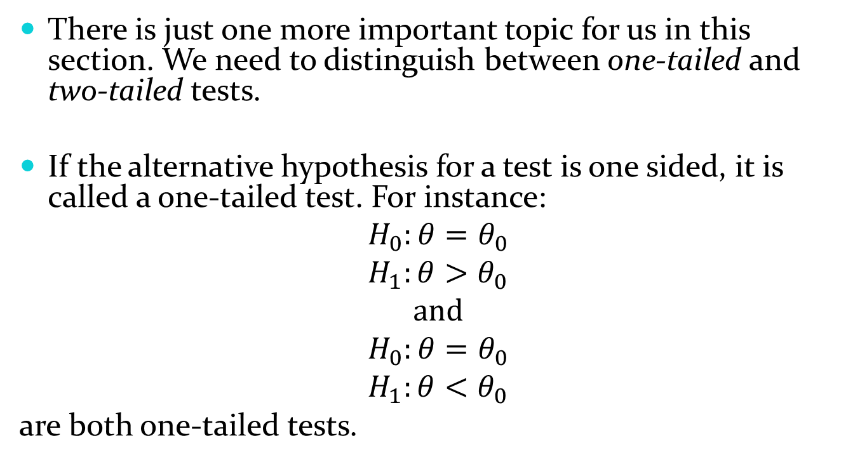
10.2 – Testing a Hypothesis
There is just one more important topic for us in this section. We need to distinguish between one-tailed and two-tailed tests.
If the alternative hypothesis for a test is one sided, it is called a one-tailed test. For instance:
$$H_{0}:θ=θ_{0}$$
$$H_{1}:θ>θ_{0}$$
$$and$$
$$H_{0}:θ=θ_{0}$$
$$H_{1}:θ<θ_{0}$$
are both one-tailed tests.

Slide 48
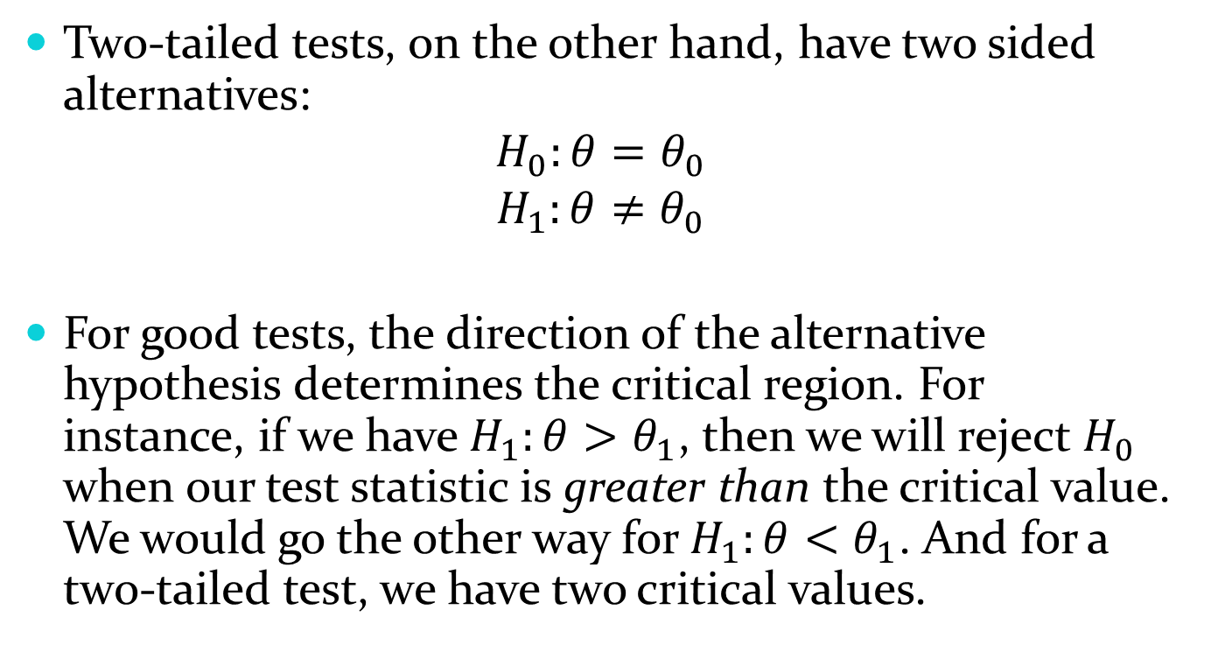
10.2 – Testing a Hypothesis
Two-tailed tests, on the other hand, have two sided alternatives:
$$H_{0}:θ=θ_{0}$$
$$H_{1}:θ≠θ_{0}$$
For good tests, the direction of the alternative hypothesis determines the critical region. For instance, if we have $H_{1}:θ>θ_{1}$, then we will reject $H_{0}$ when our test statistic is greater than the critical value. We would go the other way for $H_{1}:θ<θ_{1}$. And for a two-tailed test, we have two critical values.

Slide 49
10.2 – Testing a Hypothesis
So how do we decide whether to use a one-tailed or two-tailed test? We use the statement of the hypothesis. If a clear direction (greater than or less than) is given, then use that direction as your alternative hypothesis. If there is no direction given, then use a two sided test.
This is how we’ve set up hypotheses so far. You can go back and look at the examples we’ve done and see that we followed this rule.

Slide 50
10.3 – How to Conduct a Hypothesis Test
Before we go into tests for specific cases in 10.4 and 10.5, we need to formally introduce a p-value and then put everything together so that we know how to actually conduct a hypothesis test.
The book talks about how using a p-value is different than using a critical value. While they do make an interesting point, I think it’s also somewhat arbitrary. For this reason, we’re going to stray a little from what the book goes over in this section, but not too much.

Slide 51
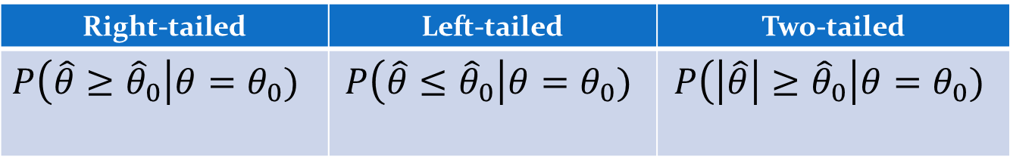
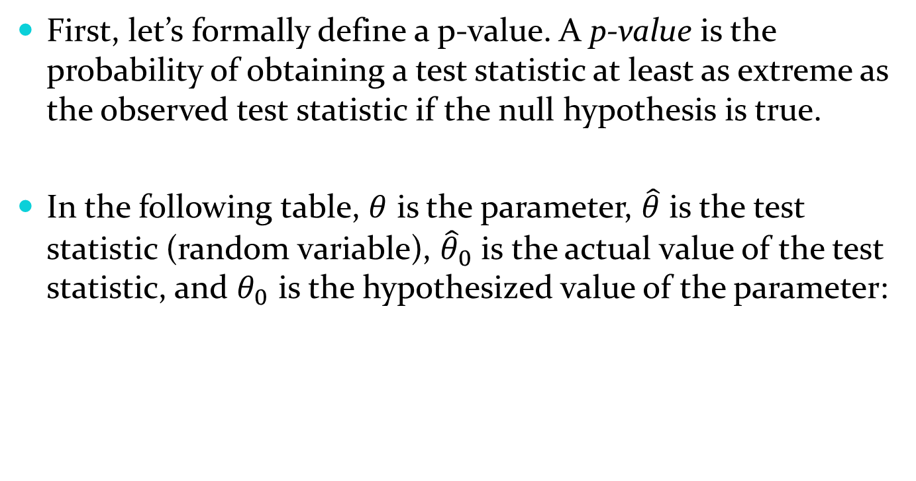
10.3 – How to Conduct a Hypothesis Test
First, let’s formally define a p-value. A p-value is the probability of obtaining a test statistic at least as extreme as the observed test statistic if the null hypothesis is true.
In the following table, $θ$ is the parameter, $\hat{θ}$ is the test statistic (random variable), ${\hat{θ}}_{0}$ is the actual value of the test statistic, and $θ_{0}$ is the hypothesized value of the parameter:
Right-tailed | Left-tailed | Two-tailed
$$P\left(\hat{θ}≥{\hat{θ}}_{0}\right|θ=θ_{0})$$ | $$P\left(\hat{θ}≤{\hat{θ}}_{0}\right|θ=θ_{0})$$ | $$P\left(\left|\hat{θ}\right|≥{\hat{θ}}_{0}\right|θ=θ_{0})$$

Slide 52
10.3 – How to Conduct a Hypothesis Test
Thinking graphically, a p-value is simply the area under the null distribution beyond the test statistic.
Note that we use the term “more extreme” because we need one definition for any kind of test – one-tailed (in either direction) or two-tailed.
The equivalence of this approach and the critical value approach are perhaps best understood using a picture.

Slide 53
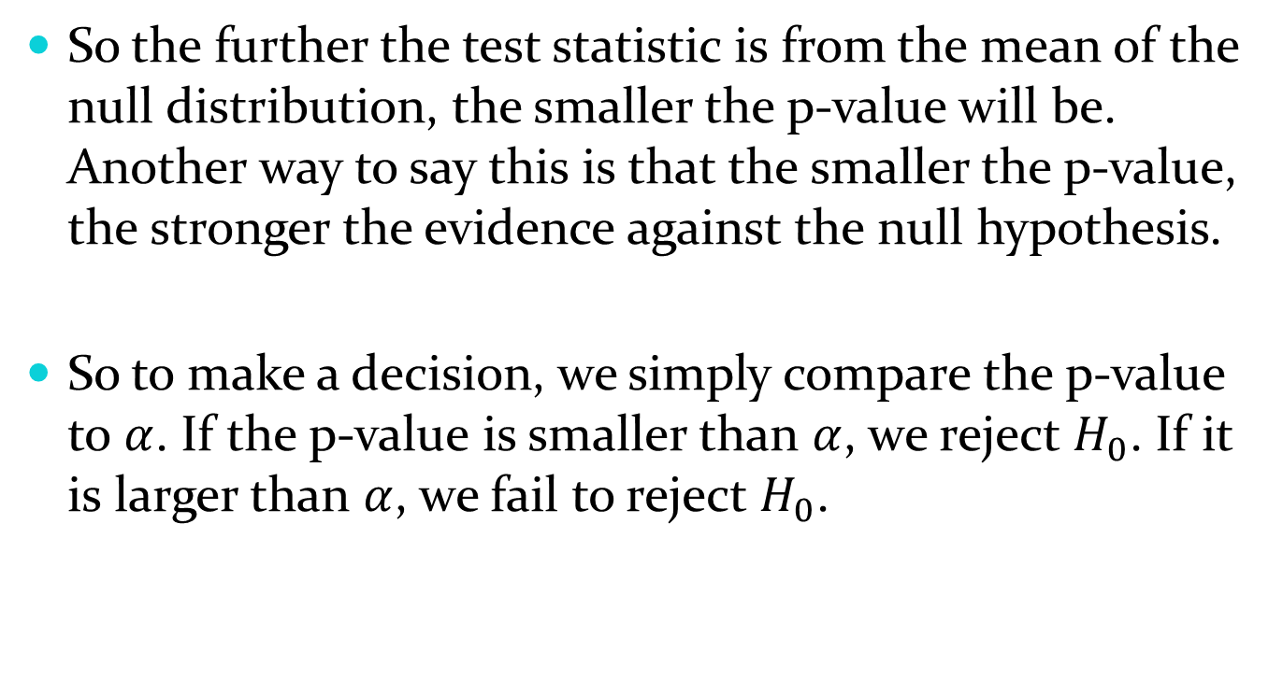
10.3 – How to Conduct a Hypothesis Test
So the further the test statistic is from the mean of the null distribution, the smaller the p-value will be. Another way to say this is that the smaller the p-value, the stronger the evidence against the null hypothesis.
So to make a decision, we simply compare the p-value to $α$. If the p-value is smaller than $α$, we reject $H_{0}$. If it is larger than $α$, we fail to reject $H_{0}$.

Slide 54
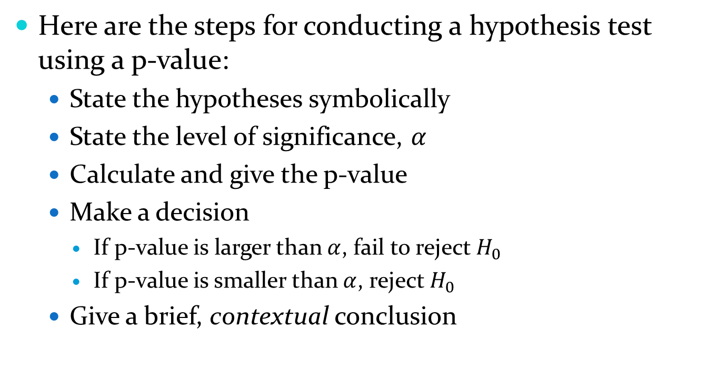
10.3 – How to Conduct a Hypothesis Test
Here are the steps for conducting a hypothesis test using a p-value:
  State the hypotheses symbolically
  State the level of significance, $α$
  Calculate and give the p-value
  Make a decision
    If p-value is larger than $α$, fail to reject $H_{0}$
    If p-value is smaller than $α$, reject $H_{0}$
  Give a brief, contextual conclusion

Slide 55
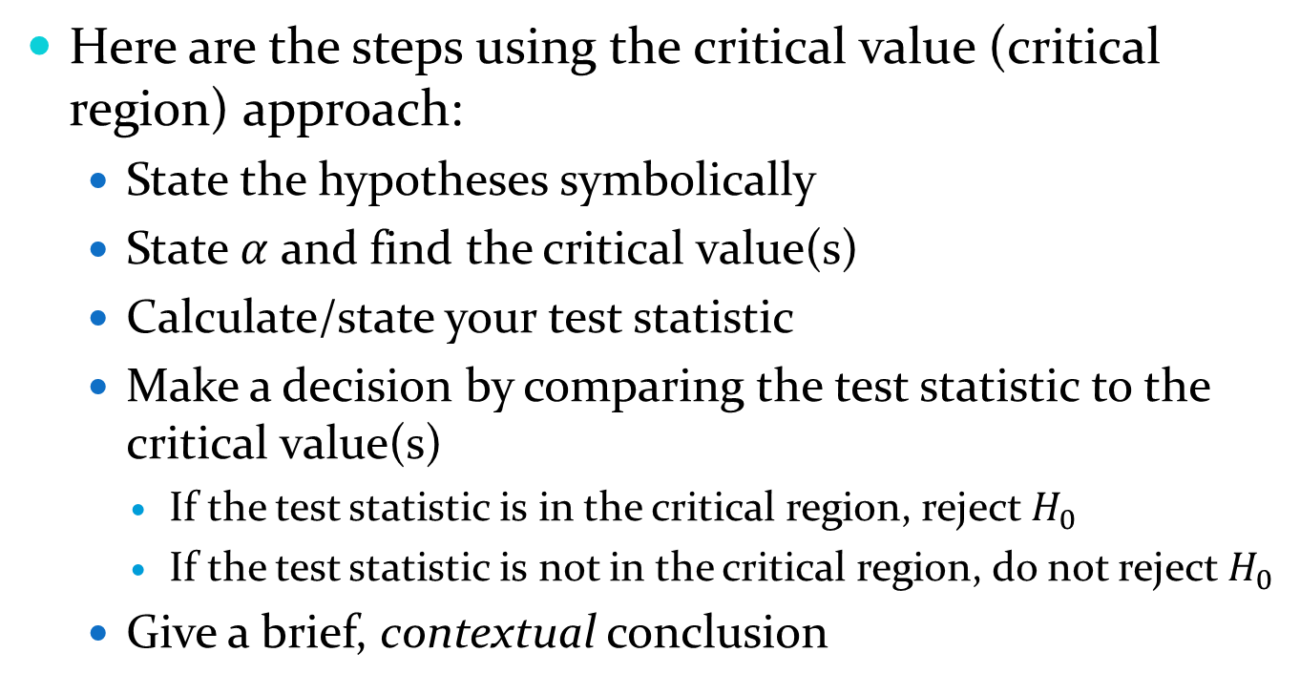
10.3 – How to Conduct a Hypothesis Test
Here are the steps using the critical value (critical region) approach:
  State the hypotheses symbolically
  State $α$ and find the critical value(s)
  Calculate/state your test statistic
  Make a decision by comparing the test statistic to the critical value(s)
    If the test statistic is in the critical region, reject $H_{0}$
    If the test statistic is not in the critical region, do not reject $H_{0}$
  Give a brief, contextual conclusion

Slide 56
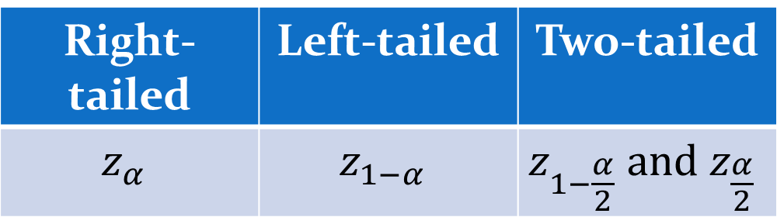
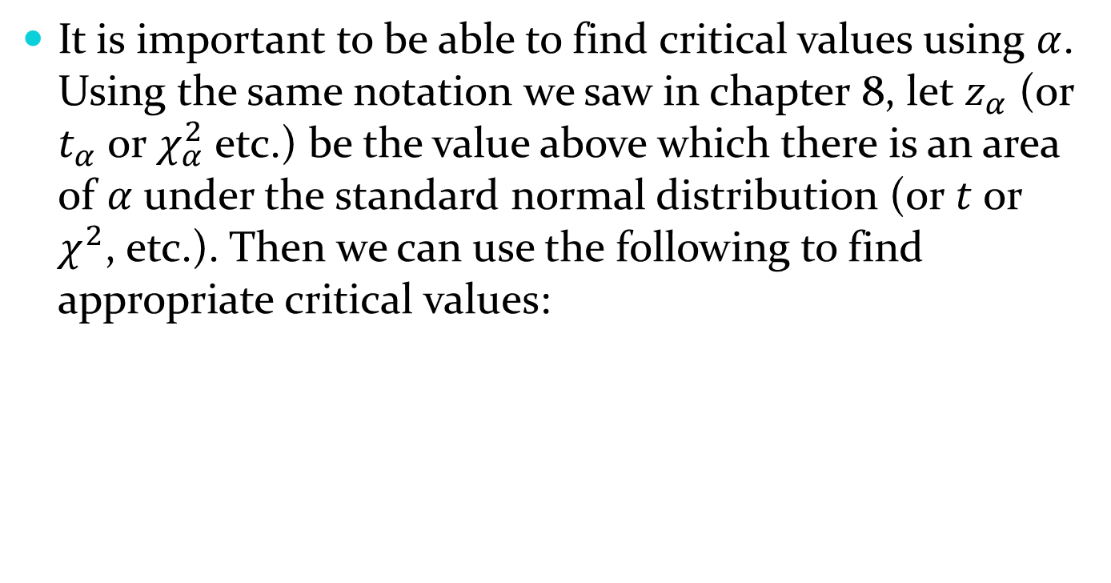
10.3 – How to Conduct a Hypothesis Test
It is important to be able to find critical values using $α$. Using the same notation we saw in chapter 8, let $z_{α}$ (or $t_{α}$ or $χ_{α}^{2}$ etc.) be the value above which there is an area of $α$ under the standard normal distribution (or $t$ or $χ^{2}$, etc.). Then we can use the following to find appropriate critical values:
Right-tailed | Left-tailed | Two-tailed
$$z_{α}$$ | $$z_{1−α}$$ | $$z_{1−\frac{α}{2}} and z_{\frac{α}{2}}$$

Slide 57

10.3 – How to Conduct a Hypothesis Test
Example: We want to know how much sleep UNL students get on a typical night. We are concerned that students are getting less sleep than they should. From a sample of 20 students, we find that $\overline{x}=7.85$ hours. Assuming $σ=1.70$ and using $α=0.05$, conduct a hypothesis test that will address our conjecture. Use a p-value to make the decision.

Slide 58
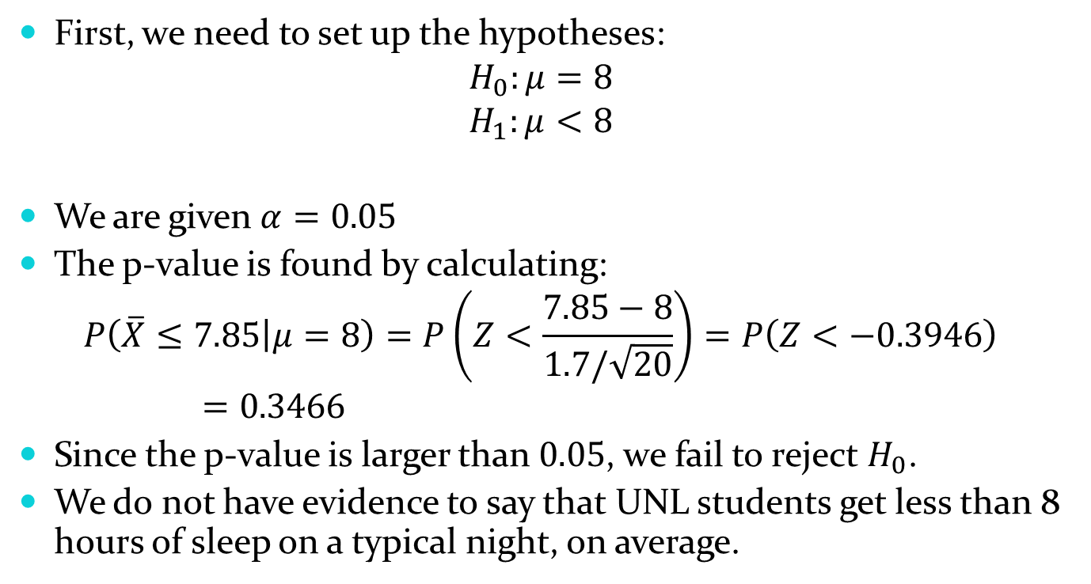
10.3 – How to Conduct a Hypothesis Test
First, we need to set up the hypotheses:
$$H_{0}:μ=8$$
$$H_{1}:μ<8$$
We are given $α=0.05$
The p-value is found by calculating:
$$P\left(\overline{X}≤7.85 | μ=8\right)=P\left(Z<\frac{7.85−8}{1.7/\sqrt{20}}\right)=P\left(Z<−0.3946\right)=0.3466$$
Since the p-value is larger than $0.05$, we fail to reject $H_{0}$.
We do not have evidence to say that UNL students get less than 8 hours of sleep on a typical night, on average.

Slide 59
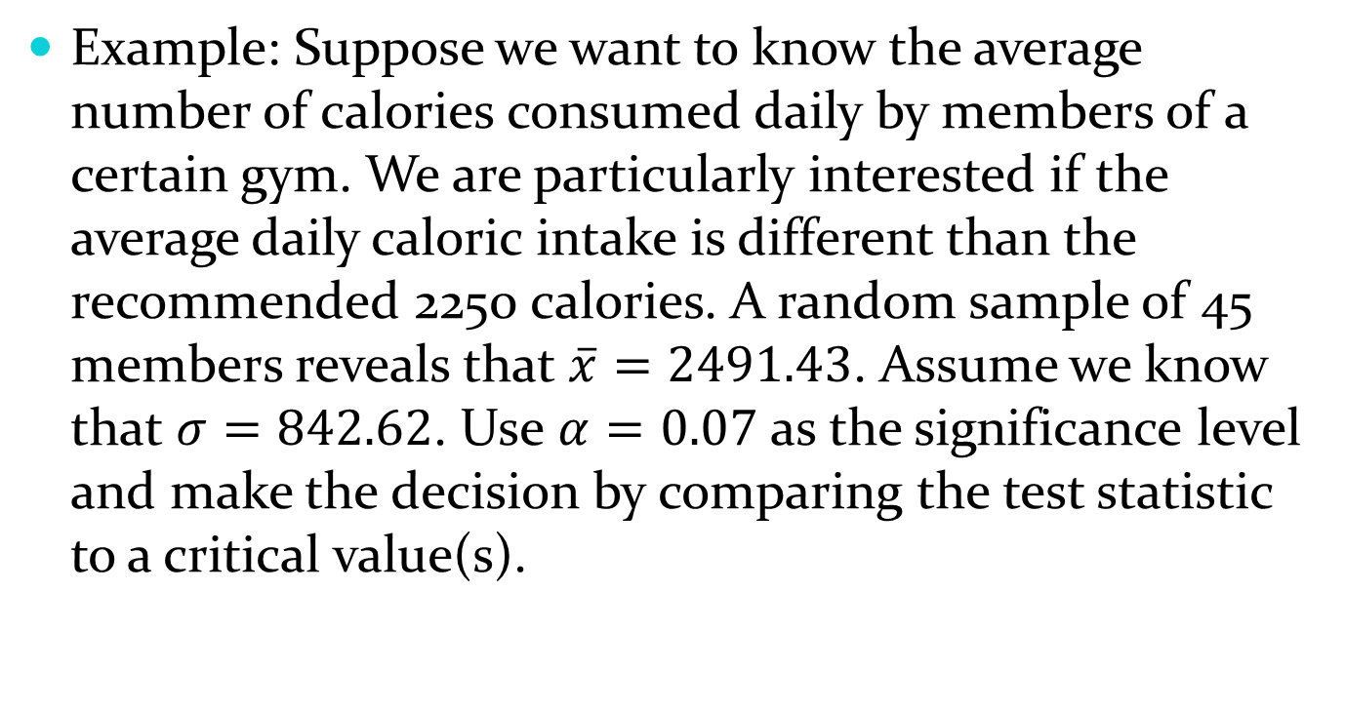
10.3 – How to Conduct a Hypothesis Test
Example: Suppose we want to know the average number of calories consumed daily by members of a certain gym. We are particularly interested if the average daily caloric intake is different than the recommended 2250 calories. A random sample of 45 members reveals that $\overline{x}=2491.43$. Assume we know that $σ=842.62$. Use $α=0.07$ as the significance level and make the decision by comparing the test statistic to a critical value(s).

Slide 60
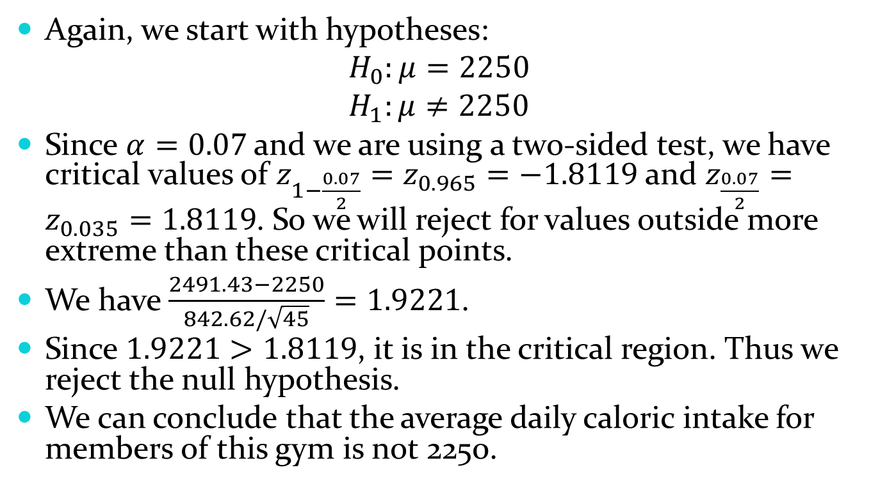
10.3 – How to Conduct a Hypothesis Test
Again, we start with hypotheses:
$$H_{0}:μ=2250$$
$$H_{1}:μ≠2250$$
Since $α=0.07$ and we are using a two-sided test, we have critical values of $z_{1−\frac{0.07}{2}}=z_{0.965}=−1.8119$ and $z_{\frac{0.07}{2}}=z_{0.035}=1.8119$. So we will reject for values outside more extreme than these critical points.
We have $\frac{2491.43−2250}{842.62/\sqrt{45}}=1.9221$.
Since $1.9221>1.8119$, it is in the critical region. Thus we reject the null hypothesis.
We can conclude that the average daily caloric intake for members of this gym is not 2250.

Slide 61
10.3 – How to Conduct a Hypothesis Test
Exercise: Do each of the previous two examples again, but use the other method. So use a critical value for the sleep example and a p-value for the calorie example.
Note that your conclusions should be the same.

